Slide 1
WPF Data Binding
Technical presentation milestone
Chris devisser (20521027)
2015-07-08

Slide 2
Presentation Information
General Questions:
  Note the slide number
  Ask at the end
  Syntax Questions:
  Some C# 6 features are used
  If syntax not covered, ask right away
  Slides and Code:
  Available on Github: https://github.com/chrisdevisser/TPM

Slide 3
Outline
  Background
  Data Binding
  Demo: Basic Math
  Summary
  Questions

Slide 4
Background
  WPF
  MVVM
  Observer Pattern

Slide 5
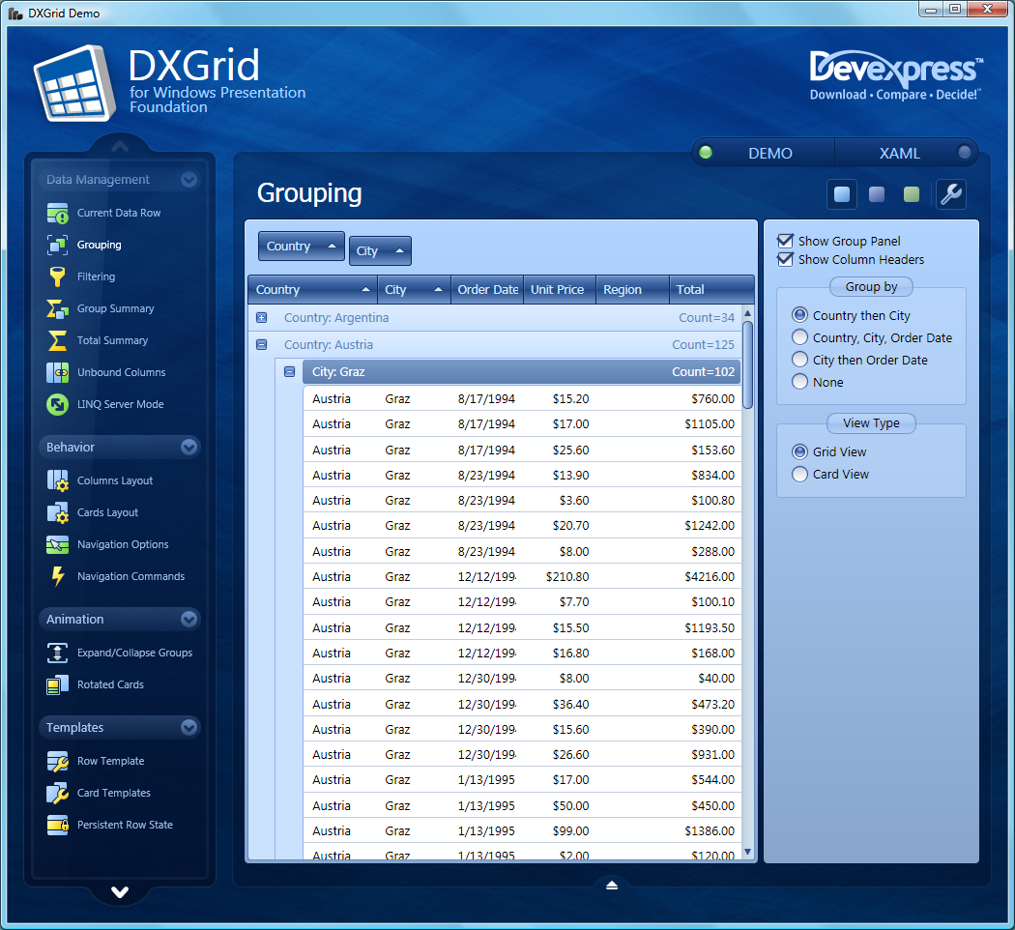
WPF
Windows Presentation Foundation
  User interface framework
  XAML
  Windows Forms
Source: https://community.devexpress.com/blogs/thinking/DXGrid%20for%20WPF.png

Slide 6
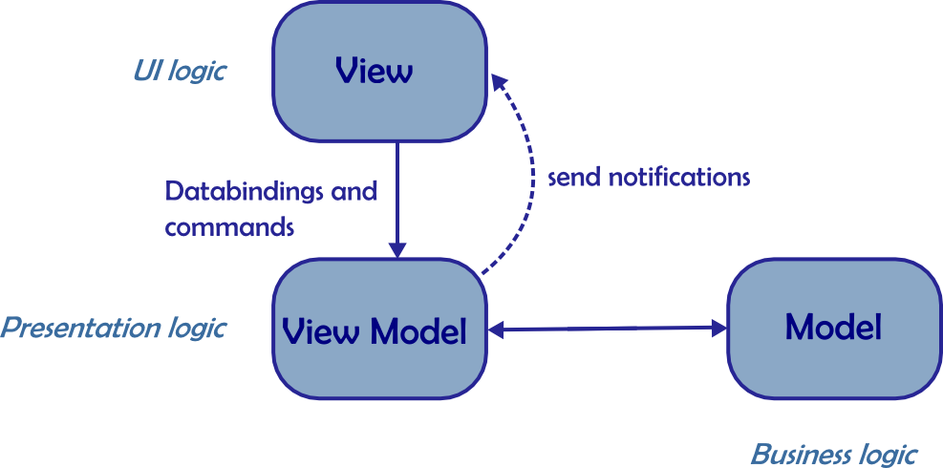
MVVM
Model – View – View Model
  Decoupled logic
  Little to no UI code
  MVP on steroids
  Testable
  Data binding and commands
Source: https://benoitpatra.files.wordpress.com/2014/03/mvvm1.png

Slide 7
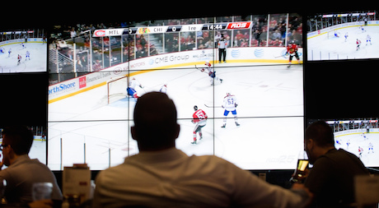
Observer Pattern
  Decouples observer and subject
  INotifyPropertyChanged
  Core of MVVM
Source: http://www.hockeyinsideout.com/wp-content/uploads/2014/10/TV.jpg

Slide 8
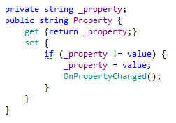
INotifyPropertyChanged Example
  Provide a PropertyChanged event and OnPropertyChanged handler
  Notify observers when properties are changed

Slide 9
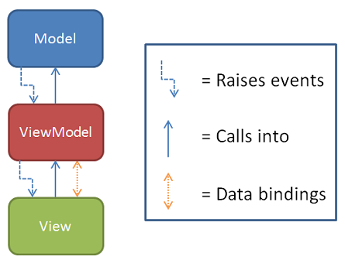
Data Binding
  View model exposes properties
  View binds directly to those properties
  Value conversions happen if needed
  That’s it!
Source: http://rarcher.azurewebsites.net/Images/binding00b.png

Slide 10

Preparing to Bind
  We need to set up the view’s data context (the view model)

Slide 11
Simple Bindings
  We just need to specify the name of the property to which to bind

Slide 12
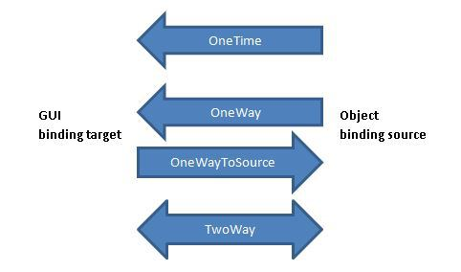
Binding Modes
  One way (default)
  Two way
  One way to source
Source: https://csharphardcoreprogramming.files.wordpress.com/2014/02/mode.jpg

Slide 13
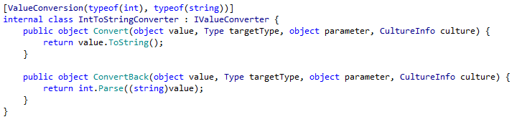
Value Conversions
  The binding might not be a perfect match (e.g., different types)

Slide 14
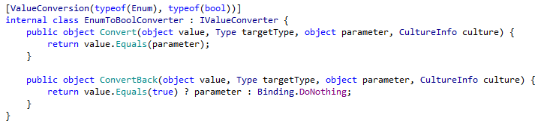
Value Conversions
  The binding might not be a perfect match (e.g., different types)

Slide 15
Demo: Basic Math
  See provided code and program
Skip demo slides

Slide 16
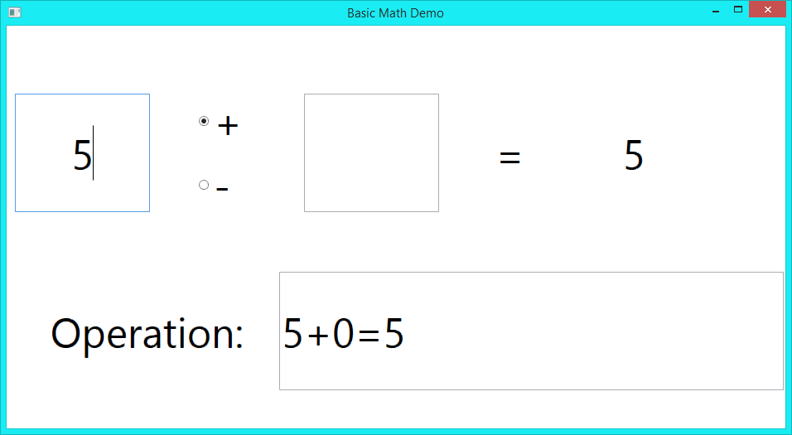
Demo: Basic Math

Slide 17
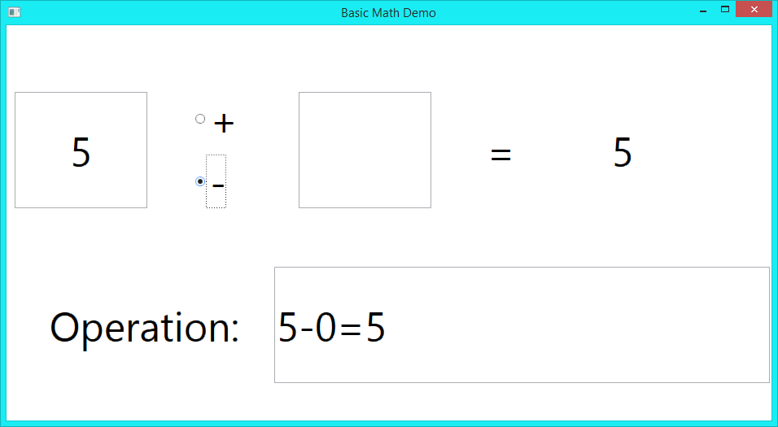
Demo: Basic Math

Slide 18
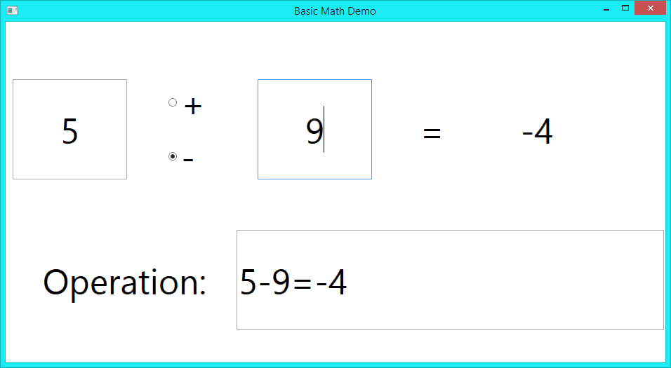
Demo: Basic Math

Slide 19
Demo: Basic Math

Slide 20
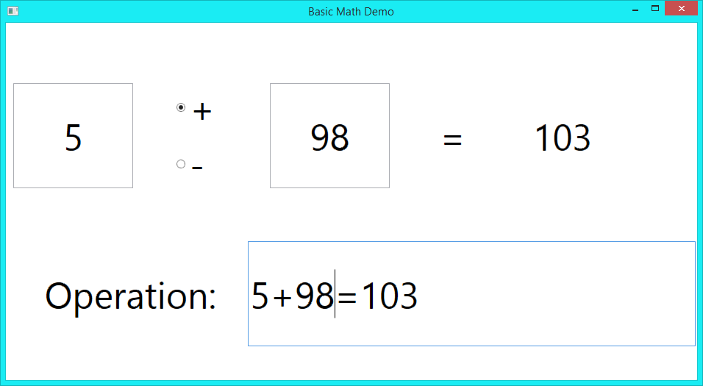
Demo: Basic Math

Slide 21
Summary
  Data bindings:
    Are powerful
    Do not require code to set up
      UI designers do not need to write C#
    Contribute to easy creation of reactive UIs

Slide 22

Questions
Source: http://images.clipartpanda.com/cool-question-marks-QuestionMarks.jpg

